Slide 1


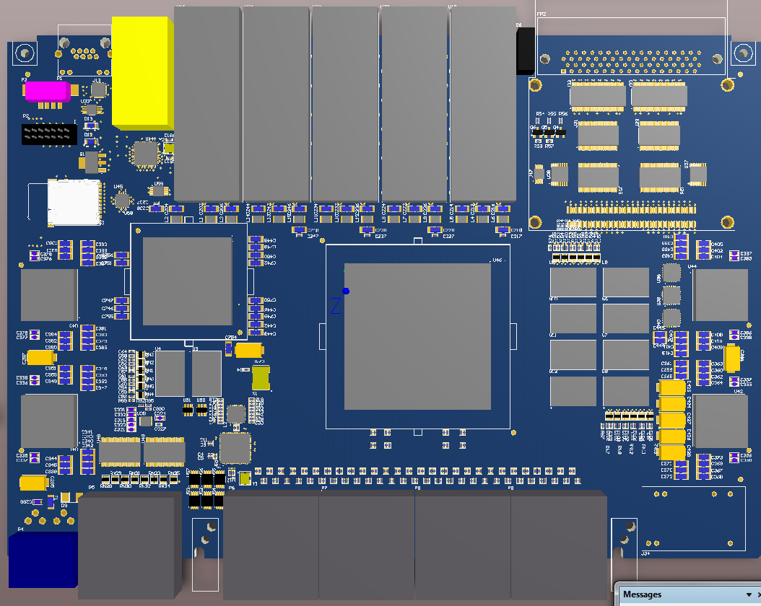

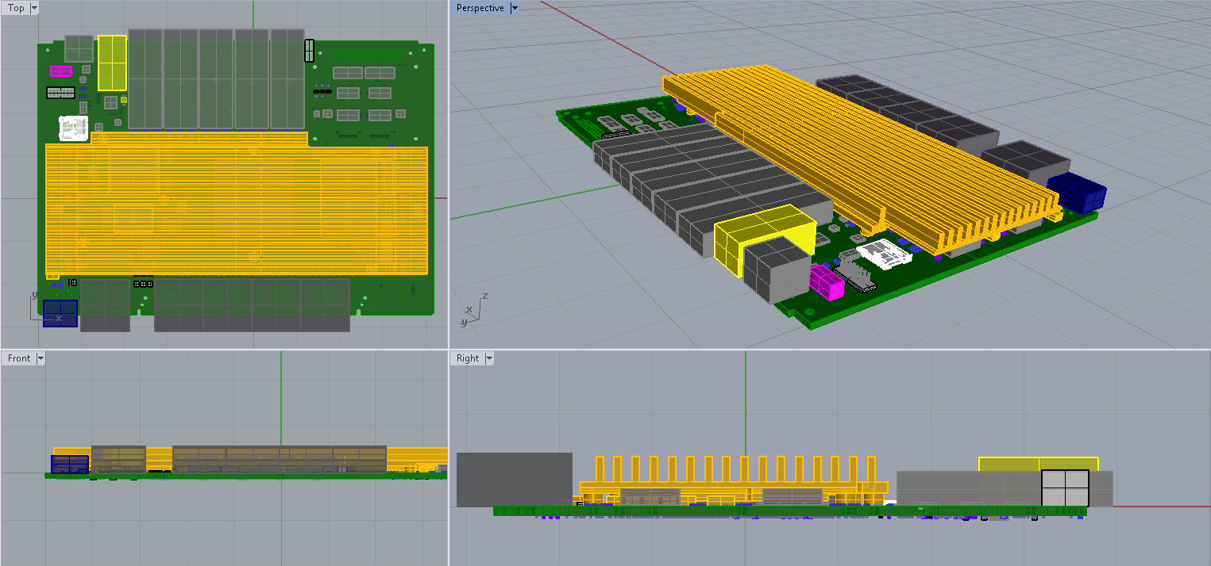
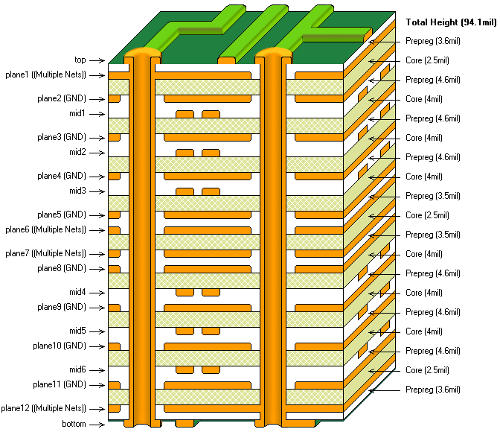
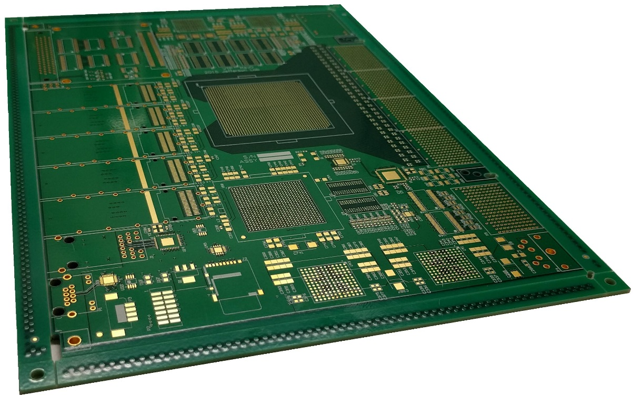
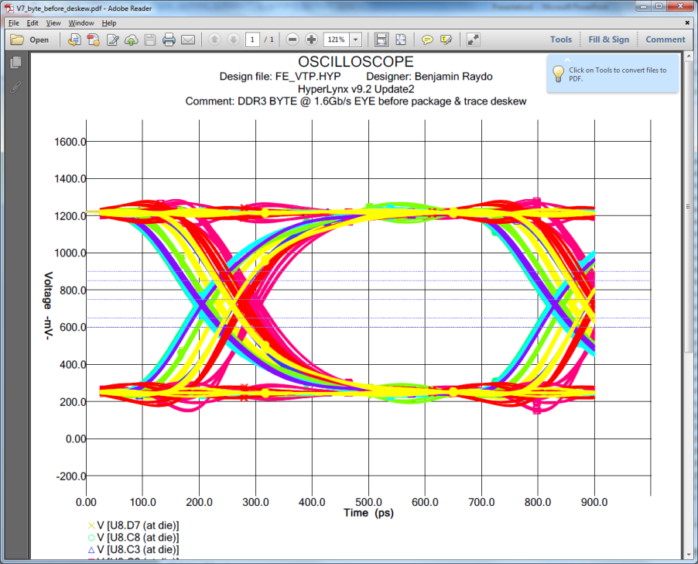
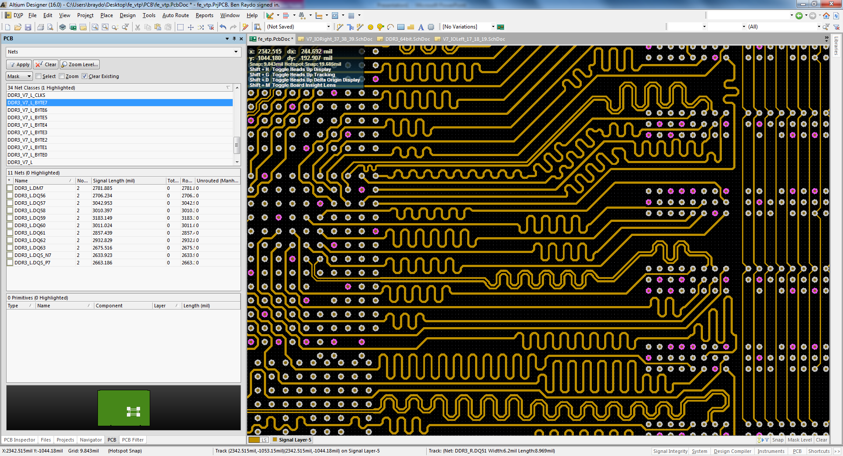
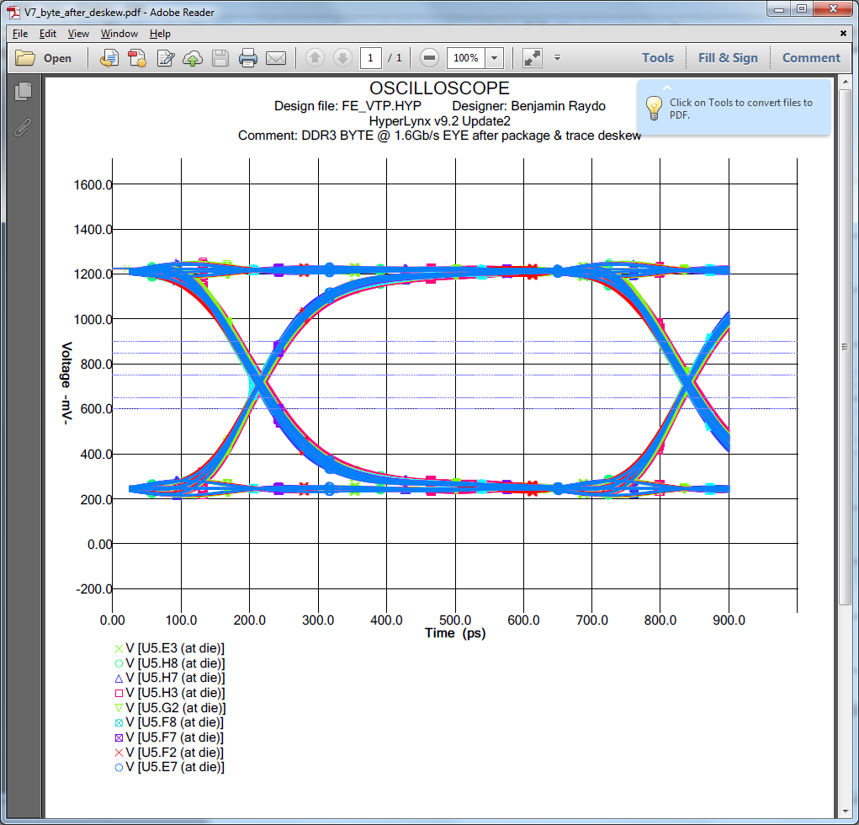
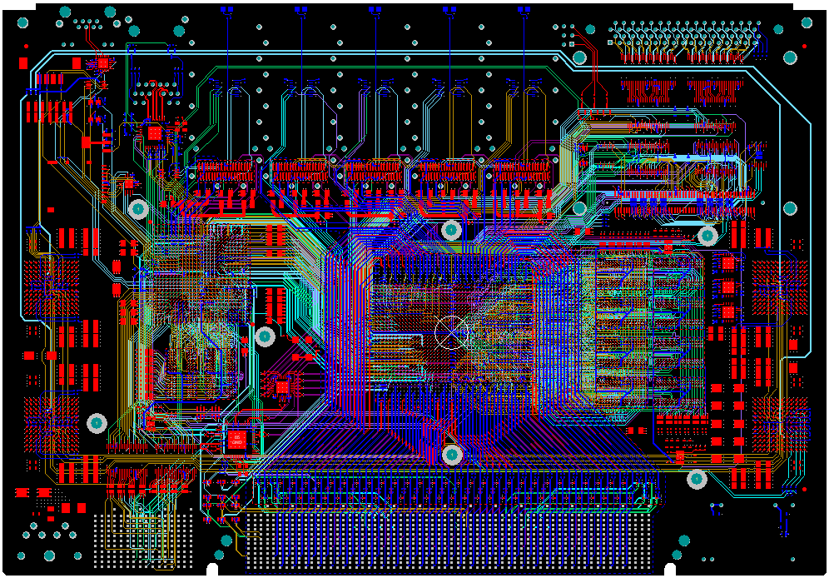
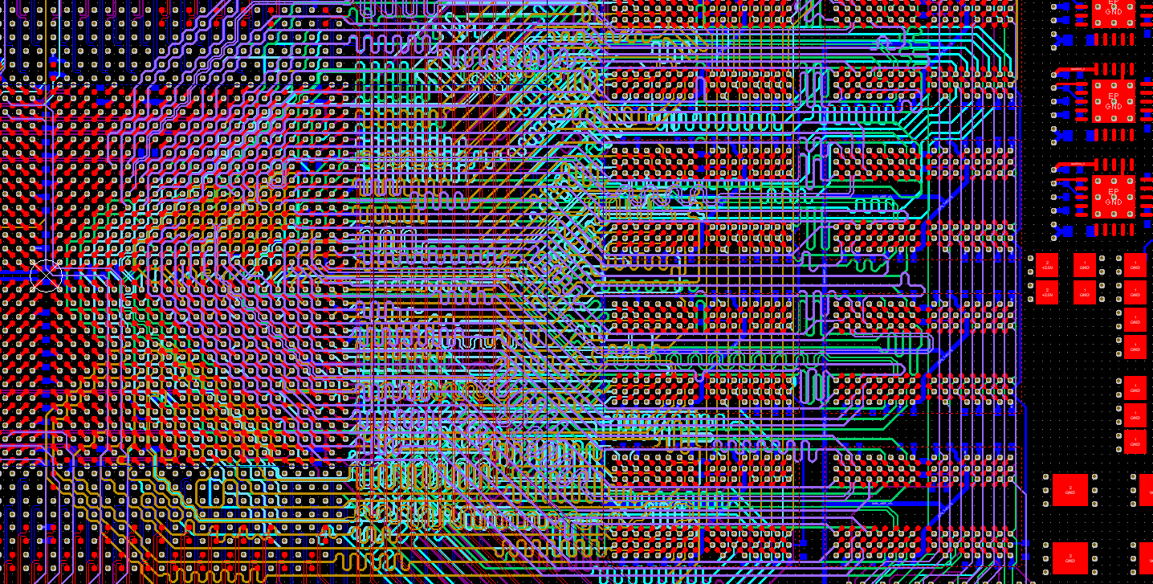
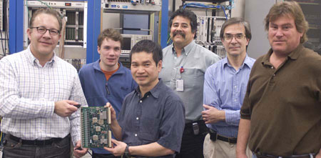
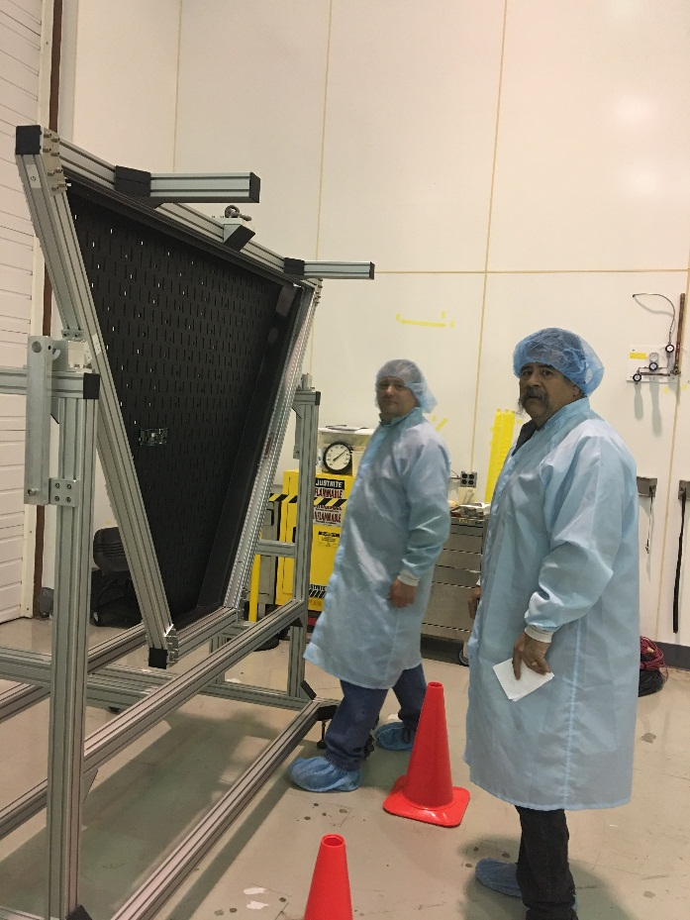
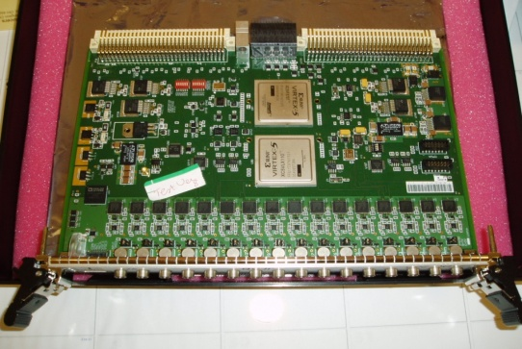
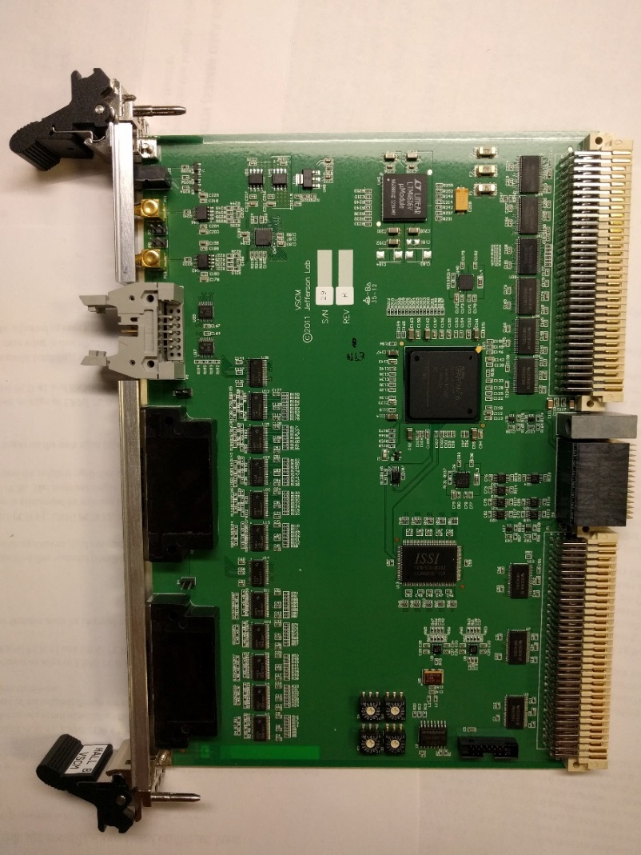
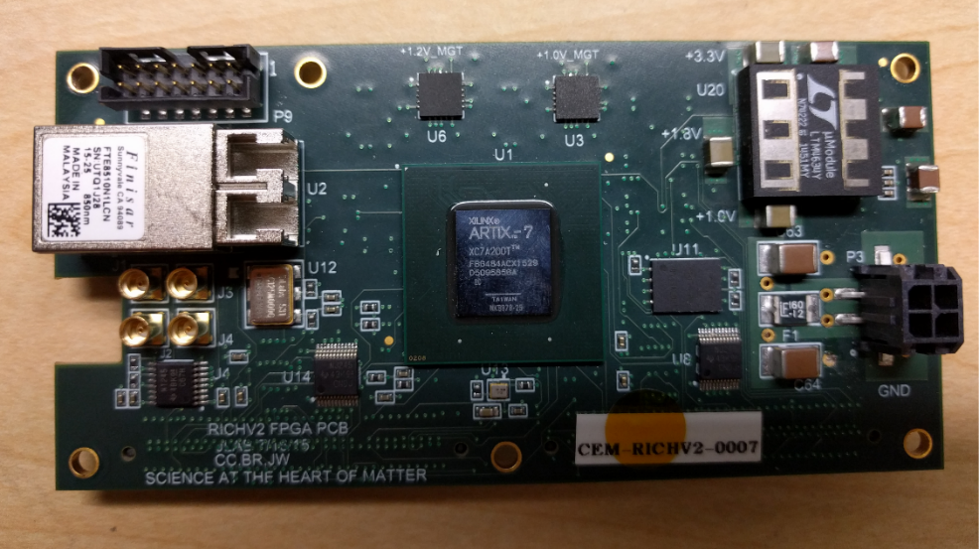
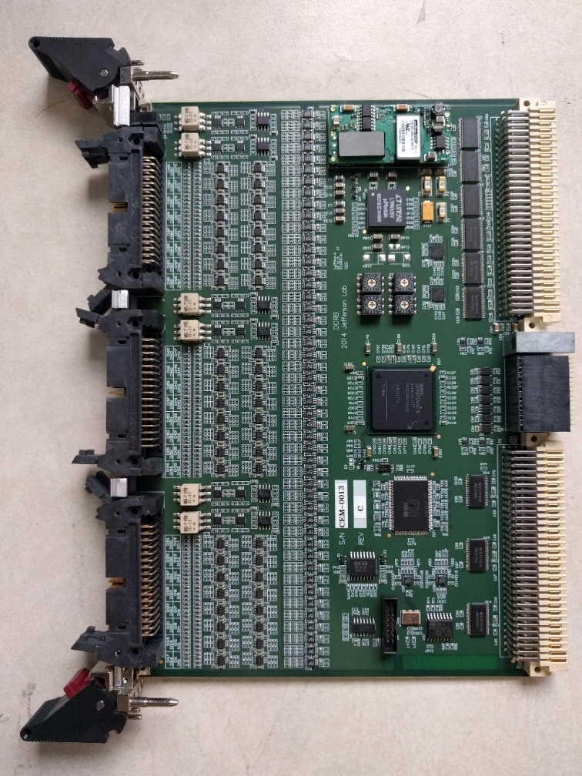
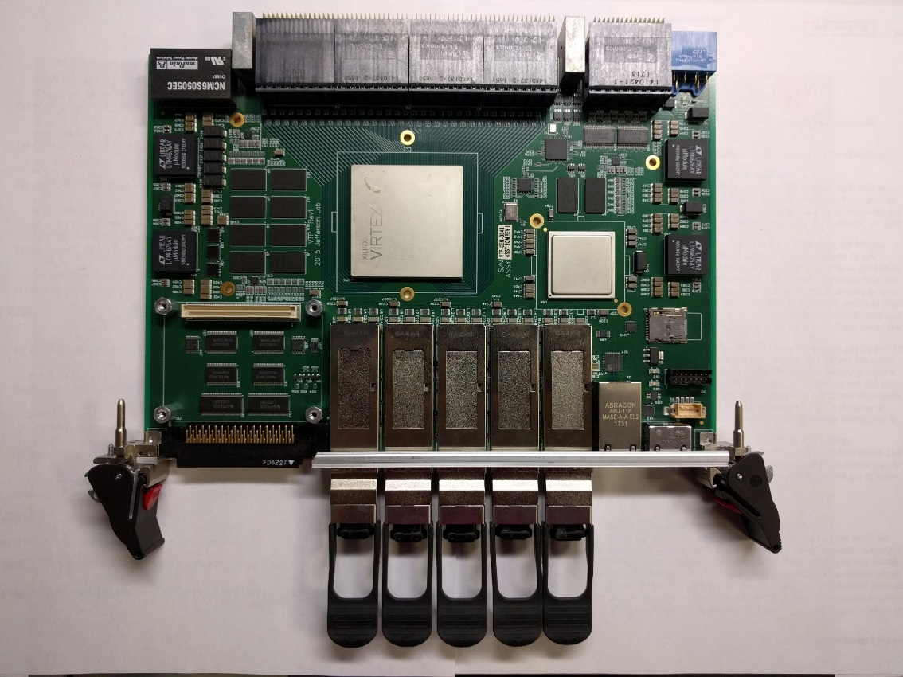
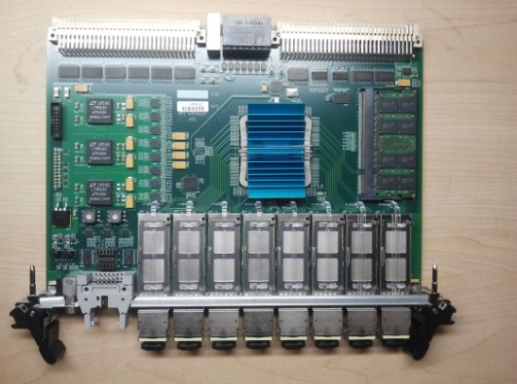
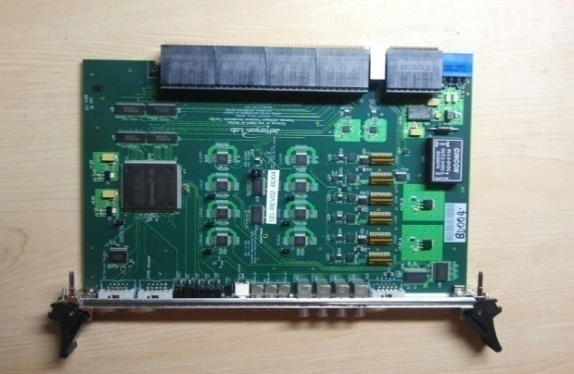
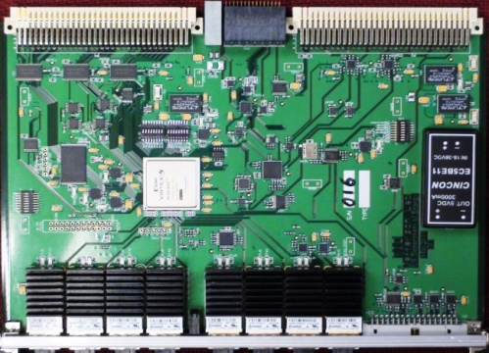
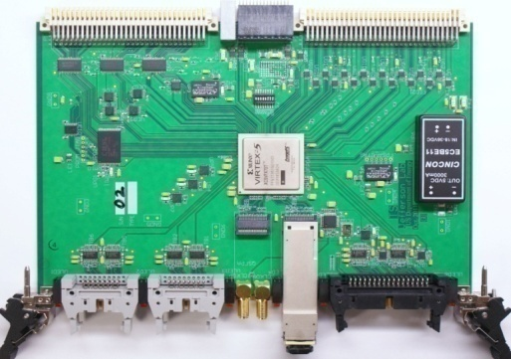
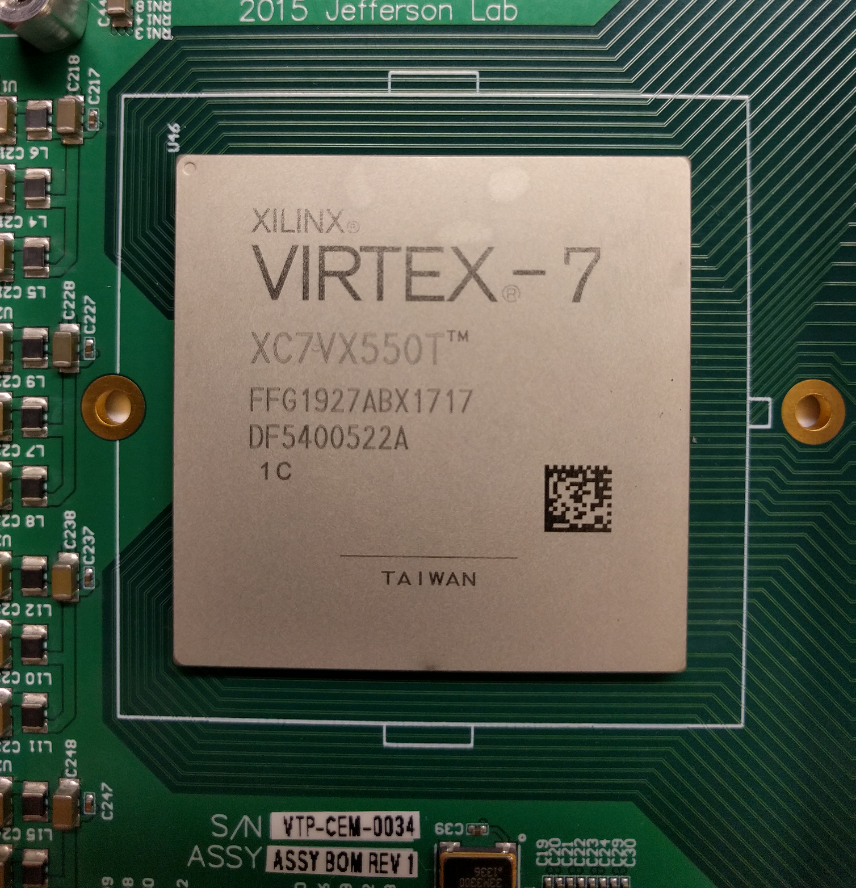
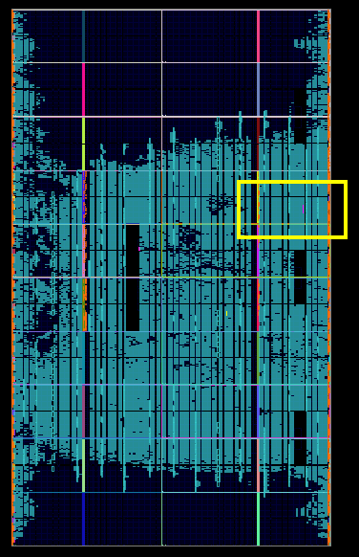
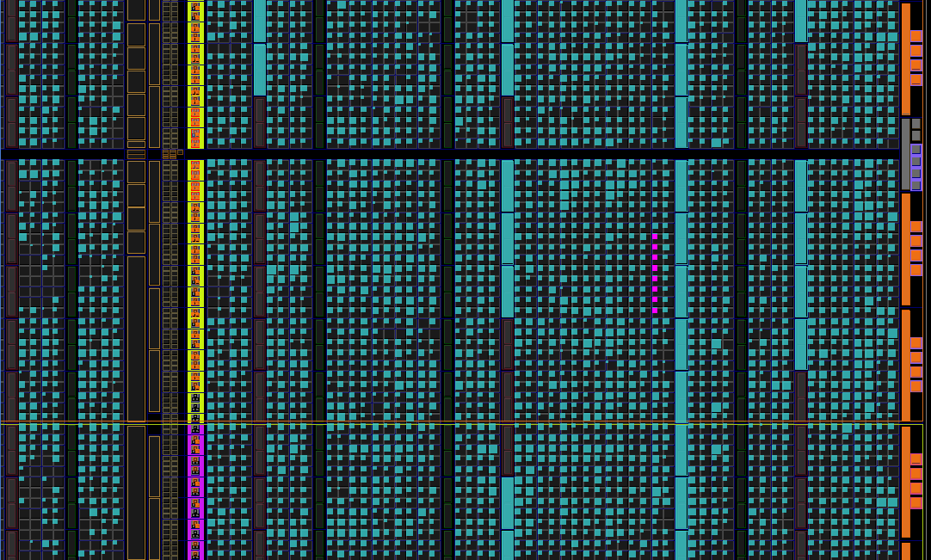
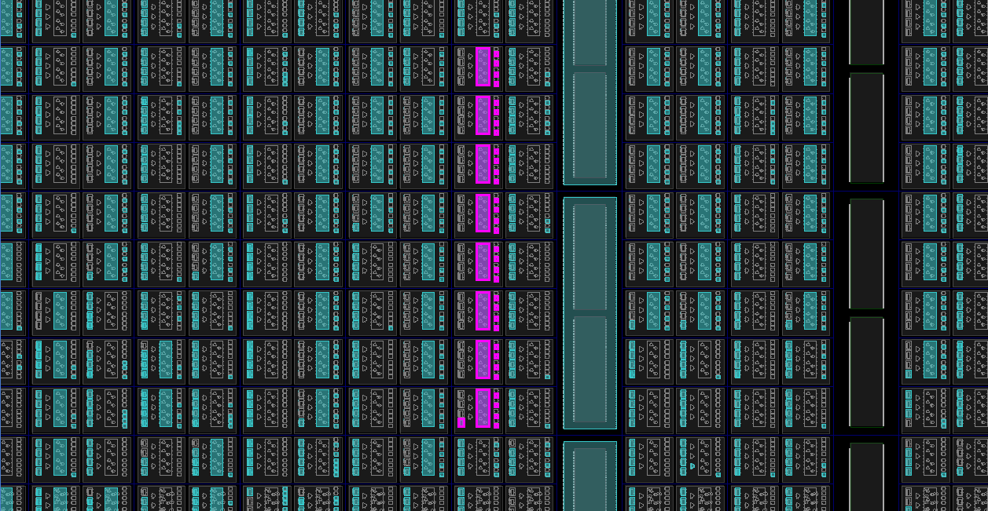
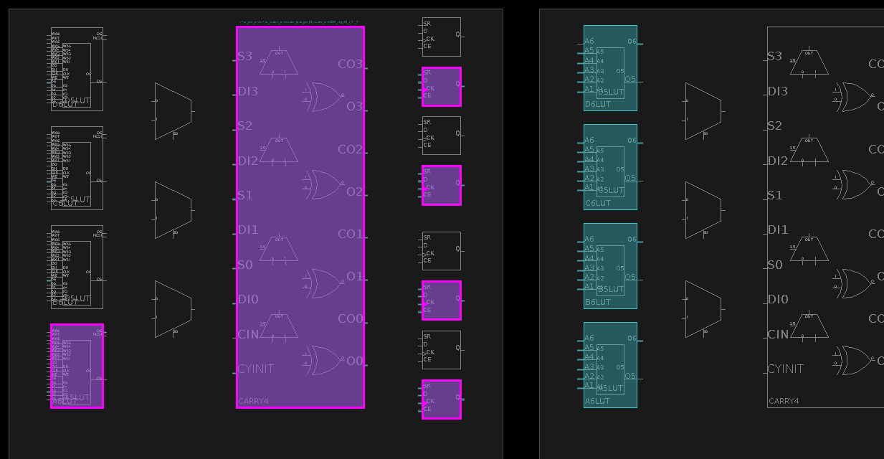
Fast Electronics
Thomas Jefferson National Accelerator Facility
How fast is “fast”?
Printed Circuit Board Physical Modeling
At Jefferson Lab we design and build circuits and firmware to:
digitize the small, ultra-fast electrical signals produced by the experimental detectors.
look for patterns in the data and select the events of interest.
The Flash Analog to Digital Converter (FADC250) samples thousands of analog signals 250 million times per second. Each of the signals can be really fast: done and gone in just a few billionths of a second.
JLab Printed Circuit Boards (PCBs) carry many integrated circuits like Field-Programmable-Gate-Arrays (FPGA), Analog-to-Digital-Converters (ADC), Serializer/Deserializer (SerDes), and many other types.
PCBs are designed in a special software package that allows mechanical modeling to make sure everything fits properly.
A custom heatsink was designed to keep cool the large integrated circuit in the center, which can consume over 40W of power on its own. Without cooling, the circuit will get hot enough to melt solder and have components fall off the board!
JLab PCB boards are composed 20 layers of copper, 19 layers of glass.
Each of the layers can carry independent connections. This is the only way we can connect thousands of components in such a compact space.
Example of JLab circuit: some compoents have nearly 2000 pins connected to the rest of the board throughout the 20 layers
Printed Circuit Board Electrical Modeling – DDR3 Memory Data
Inside a Printed Circuit Board (PCB)
We can detect if the data bits are not aligned in time, which reduces the margin for a working design:
We can measure delays of 1/10 of one billionth of a second.
Adding some wiggles in the PCB traces/wires to make all data bits show up at the same time. 1/10 of one billionth of a second delay is equal to about 1/2” of length inside the PCB.
After delay correction simulation shows all data bits are transitioning together, making the interface very reliable.
Many of our designs have many layers of copper planes and traces that deliver power and connect many signals between various integrated circuits (ICs) that are mounted on top of the PCB.
Here each color represents a different layer of copper – only 8 of the 20 are shown here.
1bit is ~600ps wide
The FADC250 and JLab Fast Electronics Group.
Custom designed electronics used in CLAS12
Front-End Detector Readout Modules
FADC250 (Qty 247 modules)
Digitizes most PMT based detectors in CLAS12
~4,000 channels that each sample at 250MHz
Streams data to trigger using 10Gb/s link
VSCM (Qty 21 modules)
Collects a total 18GB/s data from the SVT
21,504 channels
Buffers data and reads out a portion of the input data using the 200MB/s VME bus
RICHFPGA (Qty 138 modules)
Collects a total 3128GB/s data from the RICH
25,024 channels
Buffers data and reads out a portion of the input data using the 2.5Gb/s optical link
DCRB (Qty 252 modules)
Measuring time to 1ns on 24,192 channels of DC (Drift Chamber)
Buffers data and reads out a portion of the input data using the 200MB/s VME bus
FADC250
16 channel, 12bit Flash ADC
250MHz Sample rate
200MB/s VME Readout
20Gb/s Trigger Serial Link
VSCM
1024 channel SVT readout
6.72Gb/s SVT stream input
200MB/s VME Readout
RICHFPGA
192 Channel
1ns time-to-digital Converter
2.5Gb/s optical Readout
DCRB
96 Channel
Amplifier & Discriminator
1ns time-to-digital Converter
200MB/s VME Readout
Test fitting a single RICHFPGA onto the detector electronics panel
VTP
16 Payload Ports 34Gb/s = 544Gb/s
4 Fiber Ports 34Gb/s each, 1 40Gb/s
4GB DDR3 SDRAM 200Gbps
1GHz Dual Core ARM Processor
SSP
8 Fiber Ports 25Gb/s each
1 Payload Port 20Gb/s
4GB DDR2 SDRAM
200MB/s VME Readout
SD
16 Payload Port Fanout
Clock/Trigger/Sync
Low Jitter PLL (<1ps)
Low Jitter Clock Distribution
TI/TD
8 Fiber Port Optical Fanout
Clock/Trigger/Sync
Low Jitter Clock Distribution (<3ps)
TS
Global Oscillator (250MHz)
64 Trigger Inputs
Did you know?
At JLab we use links with speeds up to 10Gb/s. While these types of transceivers are much more complex compared to traditional parallel data busses, their increased performance and wiring simplifications make it worth the effort. As a comparison, this is 100 to 200 times faster than what we receive in our homes from the cable providers.
While regular photography taken in sunlight might work with shutter speeds that are 1/125th of a second, shutter speeds for high-speed photography are much faster -- as fast as 1/8000th of a second. JLab electronics are 10 thousands times faster than that.
Many of our designs use technology called Field Programmable Gate Arrays (FPGA) – with these you can write code using tiny programmable gates and RAM that let you build simple logic all the way to custom processors. See below for an example of how a 32bit counter looks like when implemented on an FPGA (it counts from 0 to ~4.3 billion)
Trigger Processing Modules
VTP searches for hit patterns & clusters in front-end crates
SSP matches data between VTP to select events on interest
Trigger & Clock Distribution Modules
SD & TI used in all DAQ readout crates
TS is the Trigger Supervisor, which tells all crates when to readout events
Inside a Field-Programmable-Gate-Array (FPGA)
FPGA integrated circuit installed on PCB
Logic Inside FPGA (Global)
Logic Inside FPGA (1/40th of chip shown): a 32bit counter
Logic Inside FPGA (1/500th of chip shown): a 32bit counter
Logic Inside FPGA (1/86,600th of chip shown): 4bit of a 32bit counter shown
This FPGA has 1,927 solder balls that connect it to the circuit board.
Closer look at the logic array inside the FPGA.
Magenta colored cells indicate where the 32bit counter logic is.
Implements any function of 6 bits
4bit
Logic
Flip Flops
Store 1 bit of information

